Slide 1

Numpy and Pandas
Avnit Bambah

Slide 2
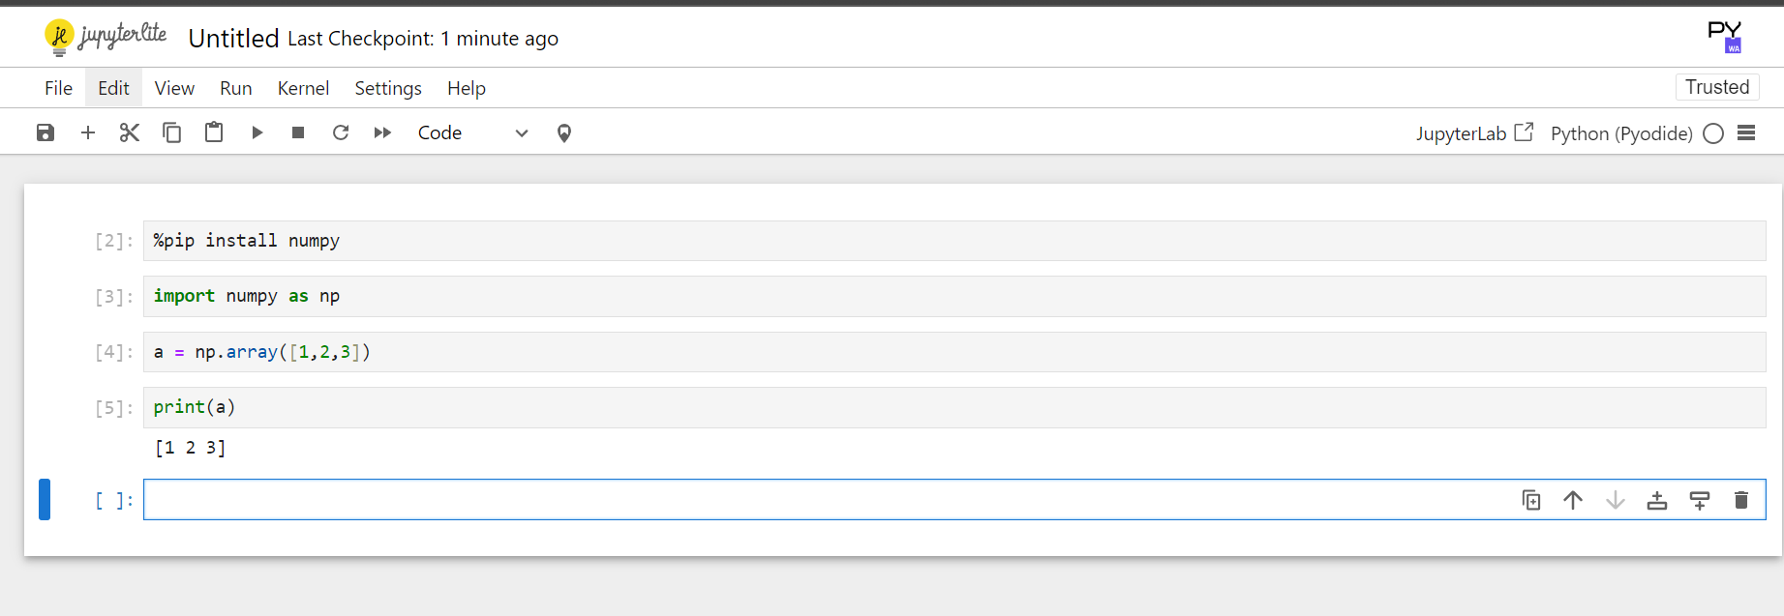
Working with Jupyter notebooks
https://jupyter.org/try-jupyter/notebooks/?path=notebooks/Intro.ipynb

Slide 3
Installing jupyter notebook or use online
pip install jupyterlab
Python –m notebook
This is a common tool used by most of the data engineers so if we are using numpy and pandas we should be using the same toolsets.

Slide 4
ARRAYS Vs List
Arrays
List
1. Non Homogenous Data Types :
More flexible than arrays, as they can store elements of different data types.
2. Used for large amount of string operations.
In Python, an array is a data structure that stores a collection of elements of the same type. It's similar to a list, but with a few key differences:
Homogeneous Data Type:
Arrays can only store elements of the same data type (e.g., integers, floats, or strings), unlike lists which can hold elements of different types.
Efficient Memory Usage:
Arrays are more memory-efficient than lists, especially when dealing with large datasets.
Specialized Operations:
Arrays offer specialized methods for mathematical operations and manipulation of numerical data.

Slide 5
IntrOucing Numpy Arrays
Simple Array Creation
Number of dimensions
Bytes of memory
used
Returns the number of bytes of used by the data portion of the array
a = np.array([1,2,3])
a.ndim
Checking the type
Array Shape (length of array along each dimension
type(a)
a.shape
a.nbytes
Numeric “Type” of Elements
Bytes per element
All the elements in the array are of same type can be changed during creation by using dtype
a.dtype
a.Itemsize

Slide 6
One Dimension And Two Dimension Array
A = Array([10,11,120])
a[0] = 10
a = Array([10,11,13],[20,21,22])
A[0,0] =10 or a[2,2] = 22
A[0] = array [10,11,13] # one dimension array

Slide 7
SLICING ONE DIMENSIONAL ARRAYS
a[1:3] array will return -4 and -3
a[1:-2] start with first element -4 and till last -2 that will be 3(8). So all elements from -4 to 3
a[-4:3] start with last -5(0) and goes to 2(7) and print from the end moving forward 3 positions. So prints nothing.
a[-5:-2] start at 0 goes to 1(6) and print from the end moving backward two position till 8 so print 1,2,3
Assume a array of element a with element -5 -4 -3 -2 -1 0 1 2 3 4
a = np.array([ -5, -4 ,-3,-2,-1,0,1,2,3,4,5])
-5 ->0
-4->1
-3->2
-2->3
-1 ->4
0->5
1->6
2->7
3->8
4->9
5->10

Slide 8
Omitting ONE DIMENSIONAL INDICES
a[:3] grab first three elements -> -5,-4,-3
a[-2:] grab last two elements
Assume a array of element a with element -5 -4 -3 -2 -1 0 1 2 3 4
a = np.array([ -5, -4 ,-3,-2,-1,0,1,2,3,4,5])
-5 ->0
-4->1
-3->2
-2->3
-1 ->4
0->5
1->6
2->7
3->8
4->9
5->10

Slide 9
Slicing TWO Dimensional Array
a[0,3:4] -> array[(4,5)]
a[1:,1:] -?
a[:,2] -> array[(3,8)]
a = np.array([[1,2,3,4,5],[6,7,8,9,10]])

Slide 10
PANDAS
Runs on top of NumPy
Very popular for data science
Pandas is an open source python library providing high performance, easy to use data structures and data analysis tools.

Slide 11
Creating Array with reshape
Task extract the 2nd and the 4th column
a=np.arange(25).reshape(5,5)

Slide 12
Pandas Vs NumPY
NumPy
Low-level data structure (np.array)
Support for large multi dimensional arrays and matrices
A wide range of mathematical array operations.
Pandas
High level data structures (data frames ).
More streamlined handling of tabular data, and rich time series functionality.
Data alignment, missing-data friendly statistics, groupby, merge and join methods.
You can use pandas data structures, and freely draw on NumPy and SciPy functions to manipulate them.
https://pandas.pydata.org/

